Slide 1

Welcome
ma.malik_hm@yahoo.com

Slide 2


Presented by
Mohammad Abdul Malik
Head Teacher
Siramishi GPS
Jagannathpur, Sunamgonj.
01716072944 ma.malik_hm@yahoo.com
Class : 2
Sub : English for today
Unit : 24
Lesson: 1
ma.malik_hm@yahoo.com

Slide 3
Warm up activities
Good morning song
ma.malik_hm@yahoo.com

Slide 4
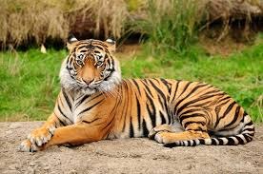
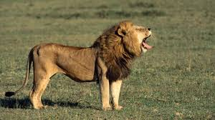
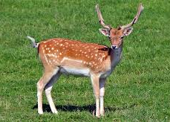
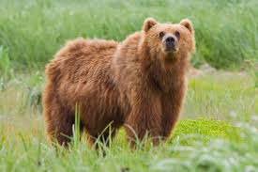
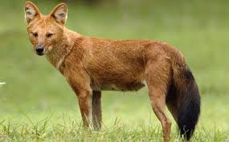
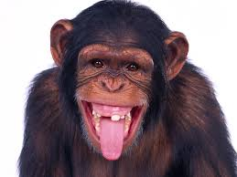
Look at the picture
Today’s lesson : Animals where they live
ma.malik_hm@yahoo.com

Slide 5
Learning outcomes:
Students will able to . . .
Listening
1.1.1 become familiar with English sounds by listening to common English words.
Speaking
1.1.1 repeat after the teacher and say words, phrases and sentences with proper sounds, stress.
ma.malik_hm@yahoo.com

Slide 6
What’s this?
What’s this?
It’s a Tiger.
It’s a fox.
ma.malik_hm@yahoo.com

Slide 7
What’s this?
What’s this?
It’s a bear.
It’s a deer.
ma.malik_hm@yahoo.com

Slide 8
What’s this?
What’s this?
It’s a lion.
It’s a monkey.
ma.malik_hm@yahoo.com

Slide 9

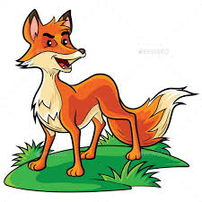
What’s this?
What’s this?
It’s a fox.
It’s a Tiger.
ma.malik_hm@yahoo.com

Slide 10
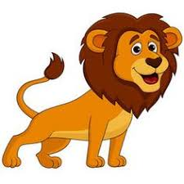
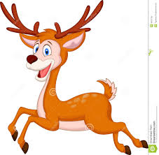
What’s this?
What’s this?
It’s a lion.
It’s a deer.
ma.malik_hm@yahoo.com

Slide 11
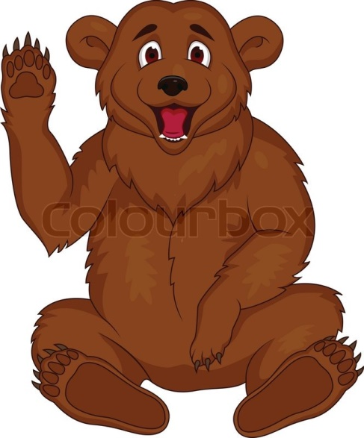

What’s this?
What’s this?
It’s bear.
It’s a monkey.
ma.malik_hm@yahoo.com

Slide 12
Listen and say after the audio.
Click here to listen.
ma.malik_hm@yahoo.com

Slide 13


GW
Please open page at 48
Please every 4 make a group. Anyone point the picture and rest of them say the name of the picture.
ma.malik_hm@yahoo.com

Slide 14
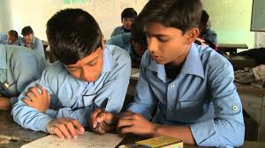
PW
Please every 2 make a pair and practice point and say by using text book.
ma.malik_hm@yahoo.com

Slide 15
Memory game
monkey
bear
tiger
Say the missing word
deer
fox
lion
ma.malik_hm@yahoo.com

Slide 16
Match the word with picture
deer
tiger
fox
ma.malik_hm@yahoo.com

Slide 17

monkey
bear
lion
ma.malik_hm@yahoo.com

Slide 18

ma.malik_hm@yahoo.com

